Slide 1
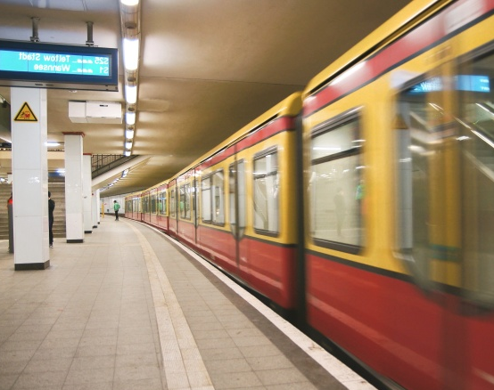
Metro Ticket Booking Project
Group – A
Batch – 97
THBS Specialization Training

Slide 2
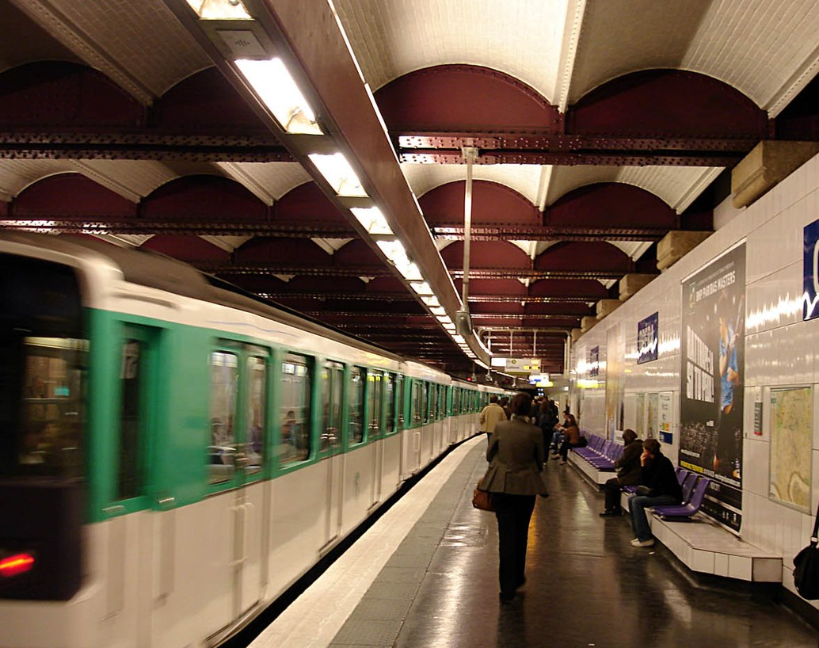
Team Members:-
Nikita Japade
Poojashree Srinivas
Ravikiran G R
Shubha Vijaykumar
Tanmay Upadhyay
This Photo by Unknown author is licensed under CC BY-SA.

Slide 3
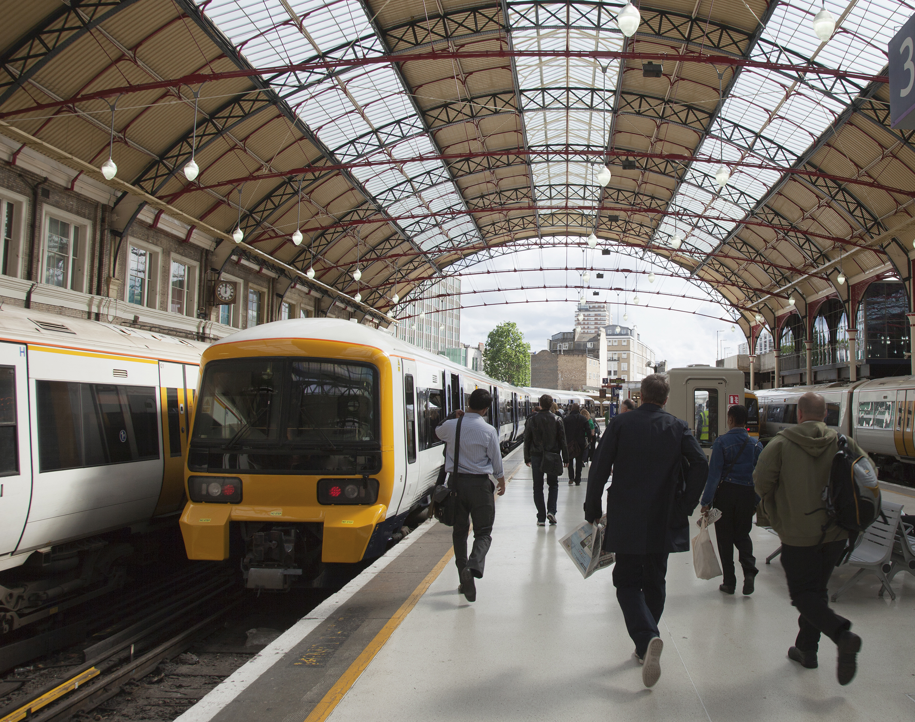
Problem Statement -
TO CREATE A METRO TICKET BOOKING SYSTEM THAT ALLOWS:-
1. Users to book Train tickets online.
2. User can also view the fair details and the route map.
3.An admin login page where admin can add trains, routes.

Slide 4
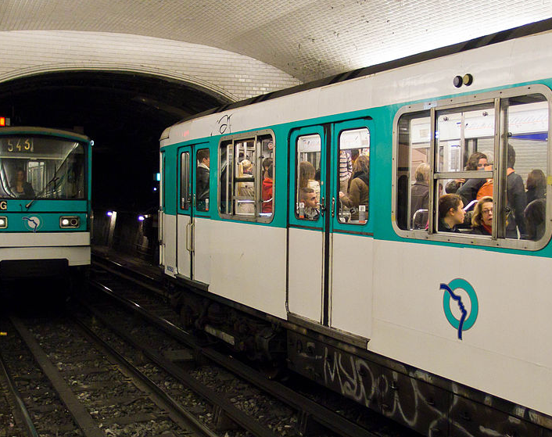
Description:-
It is going to provide a metro train ticket reservation system to public.
This is a service which will provide all information about the metro rail and it’s routes, fairs to public.
After login with verified credentials user can easily able to book a metro ticket.
This Photo by Unknown author is licensed under CC BY-SA.

Slide 5
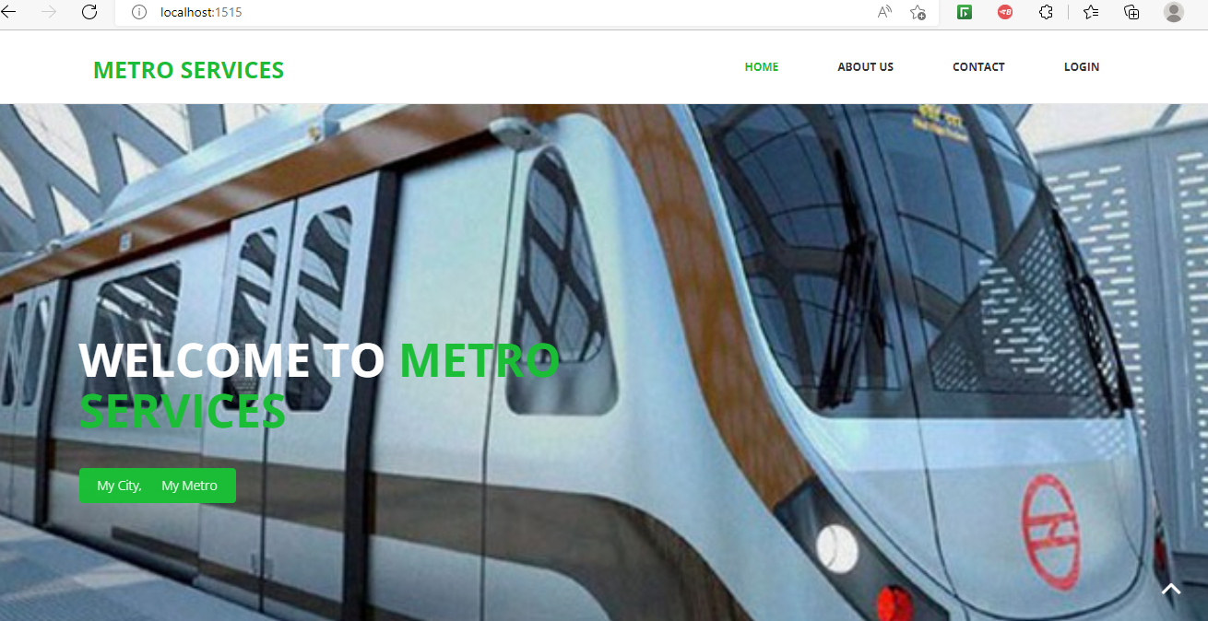
Landing Page

Slide 6
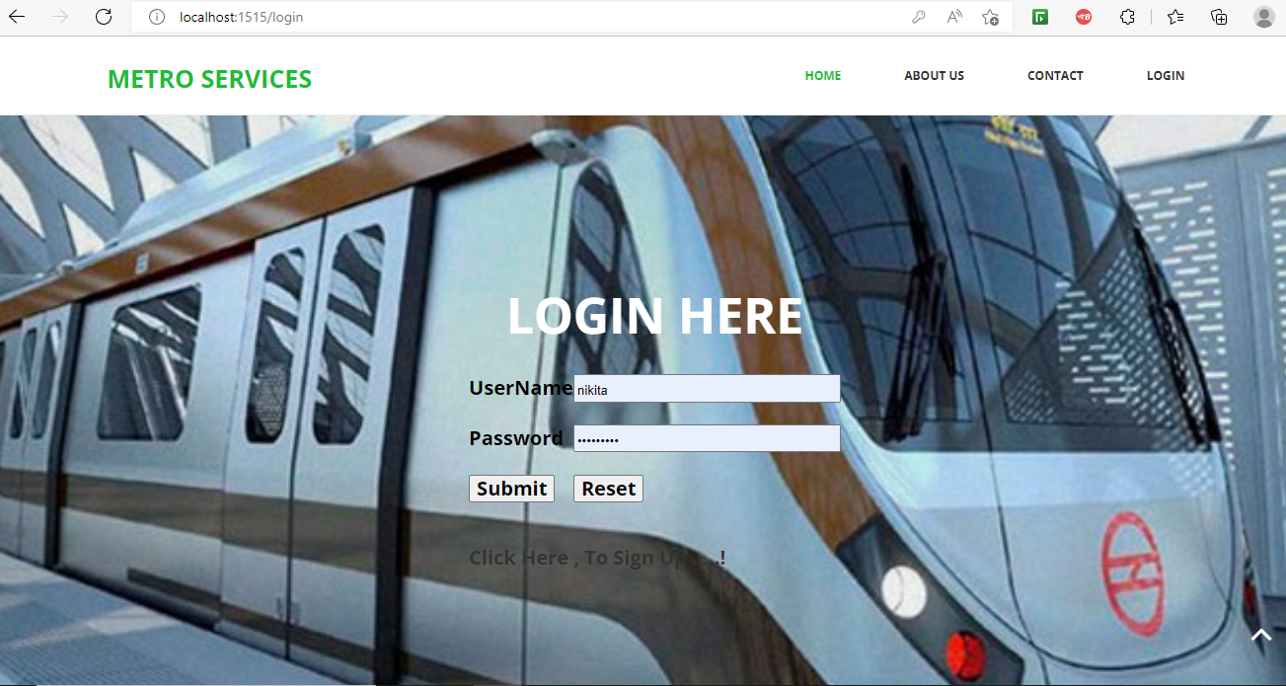
Login Page

Slide 7
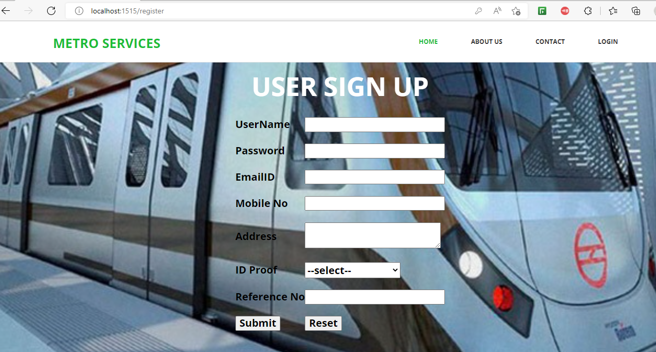
SignUp Page

Slide 8
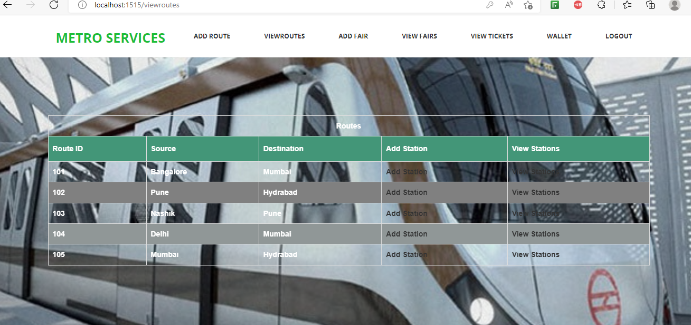
Admin Page

Slide 9
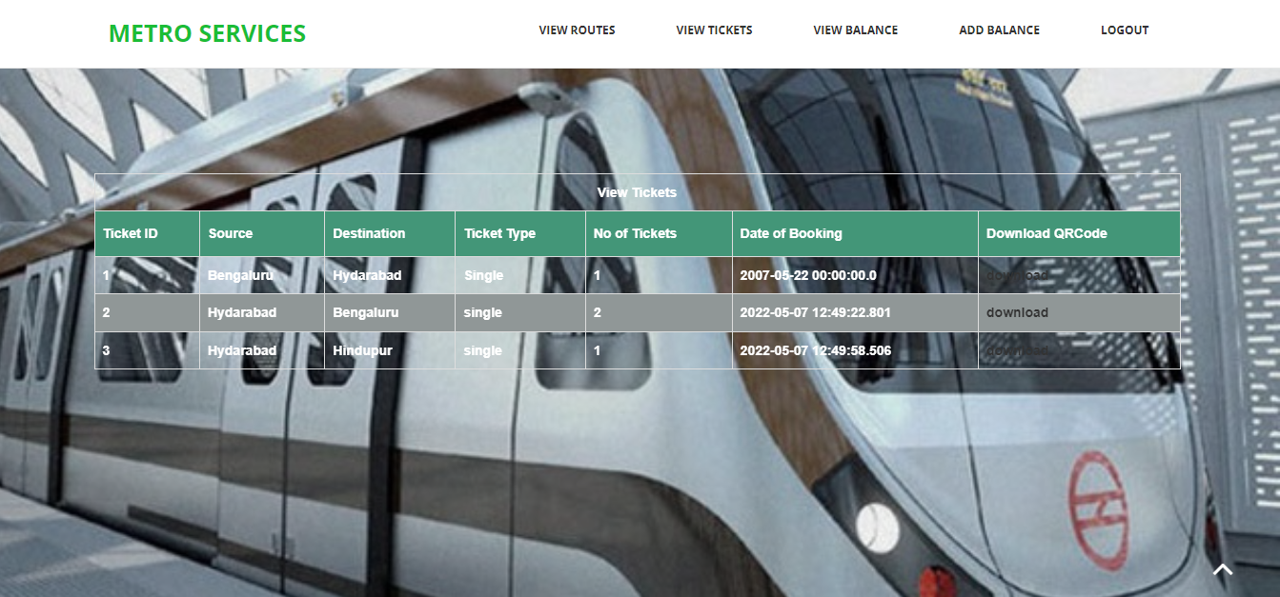
View Routes

Slide 10
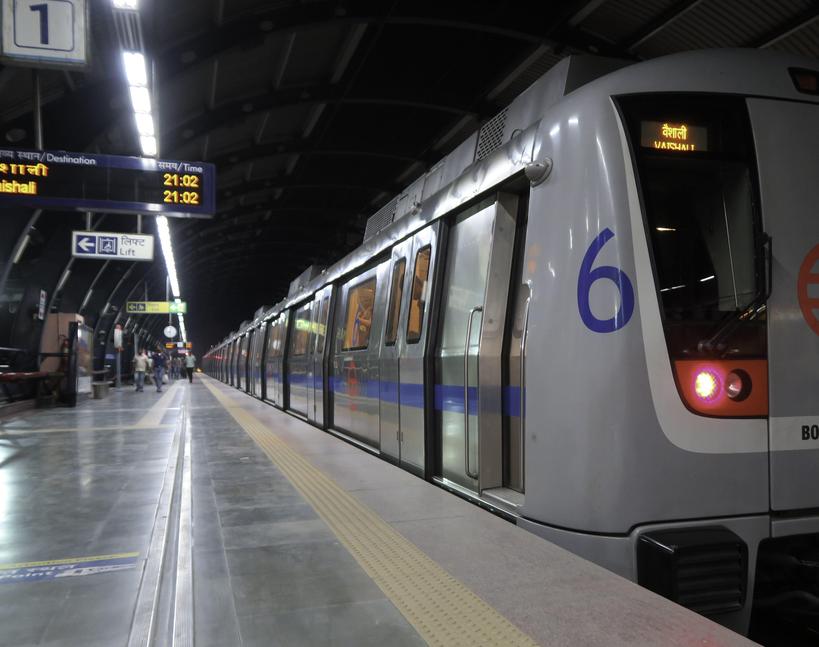
Technology Used:-
HTML, CSS, Javascript
Backend: Java Hibernate MYSQL
Spring Boot
Tools Used:-
MYSQL Workbench
STS

Slide 11
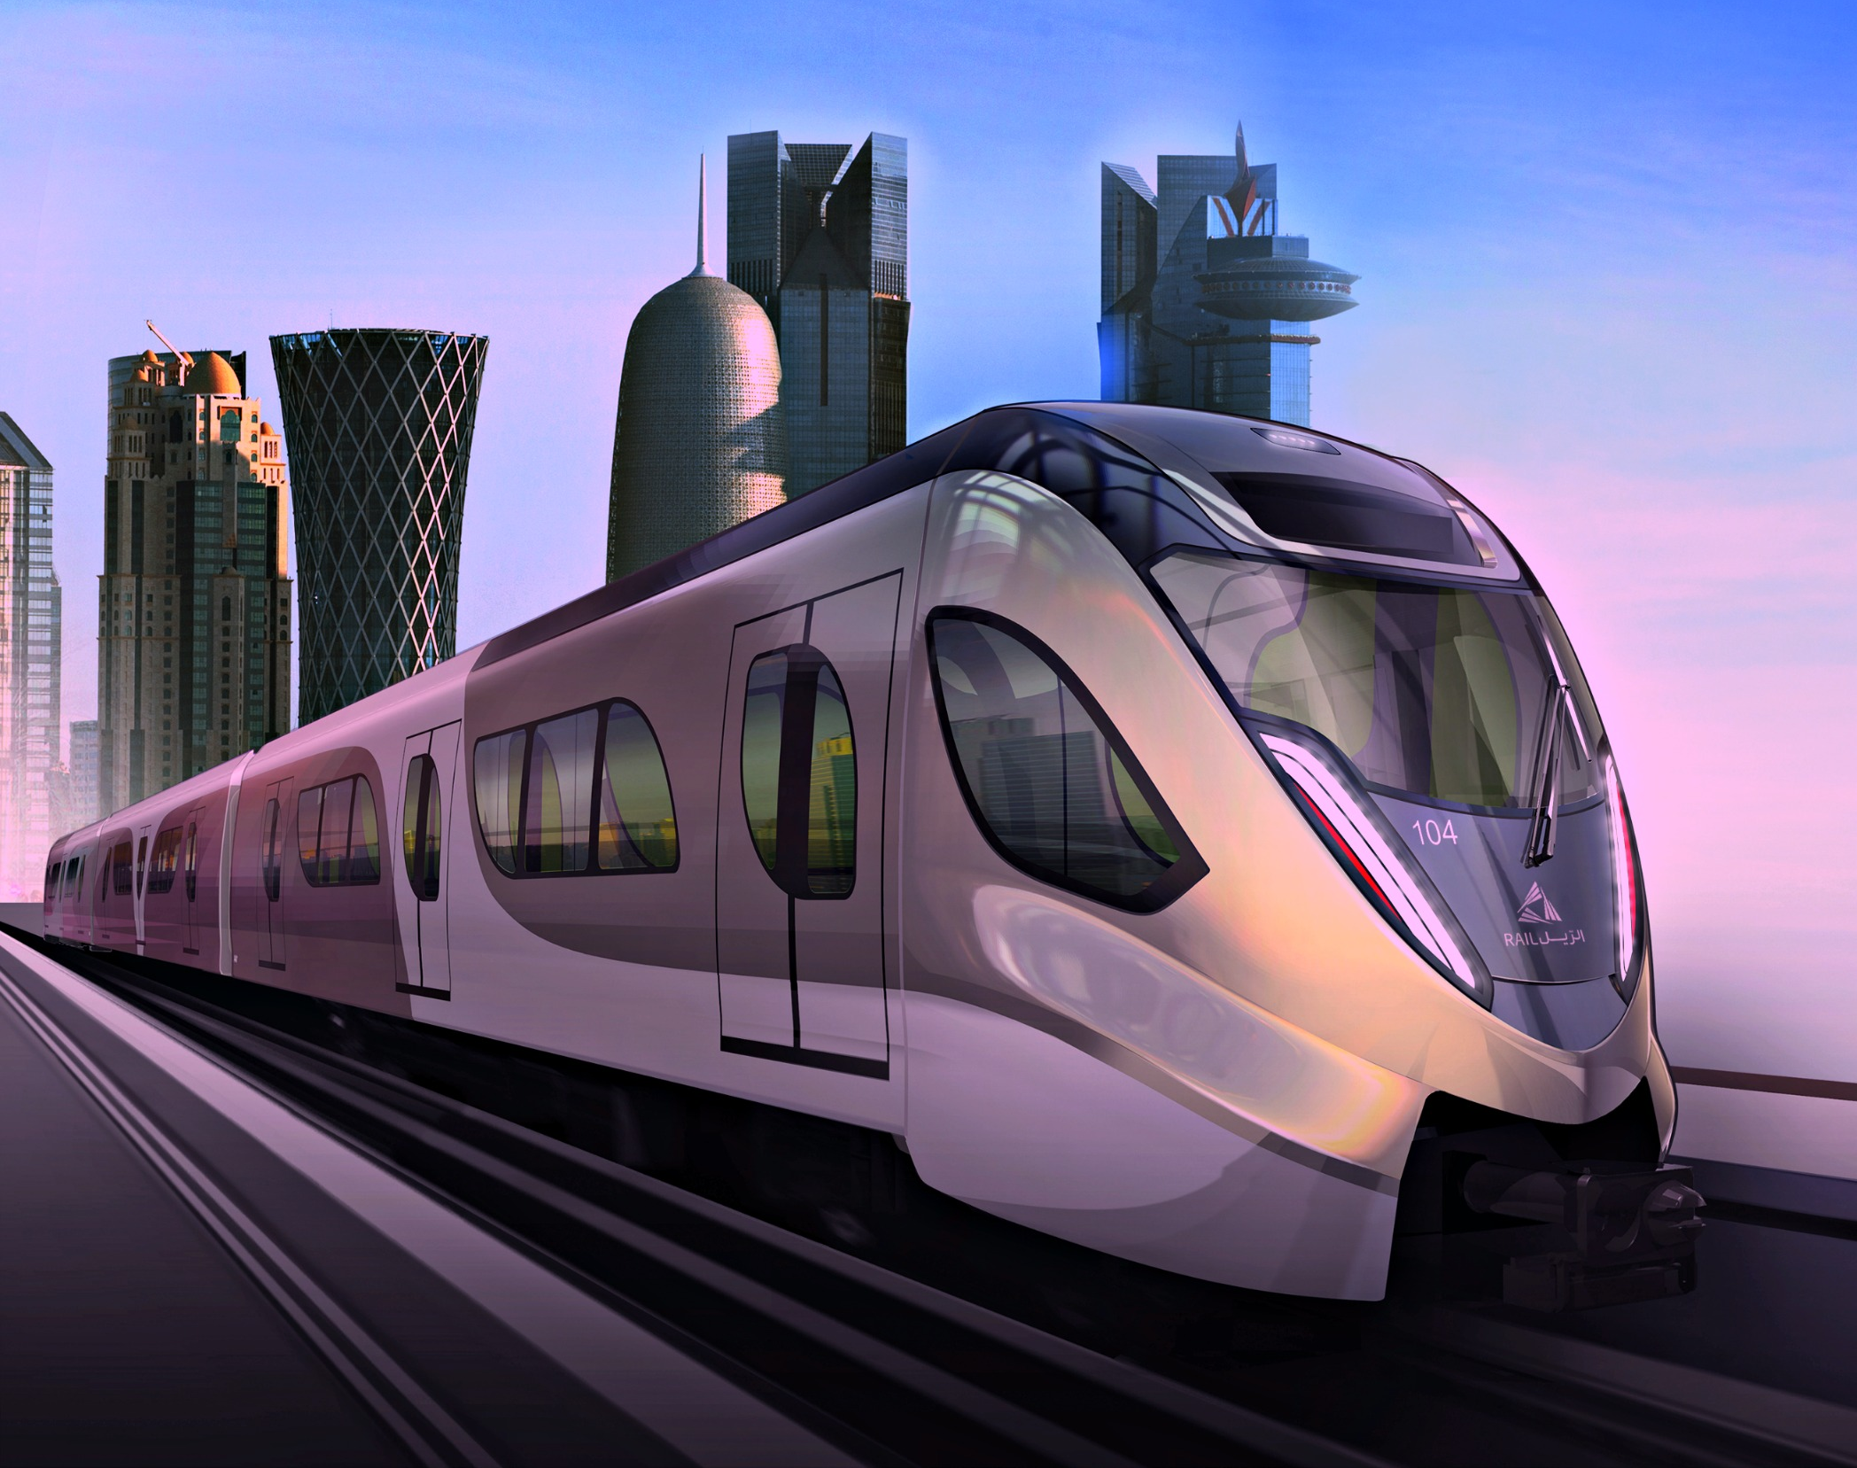
Key Advantages:-
Easier Access.
Provide accurate information to the user for taking necessary decisions.
The options used can be easily accessed, used and realized.
Efficiency - Information can be collected, processed and communicated more quickly and efficiently. Systems ensure that right information reaches the right person at the right time.
This Photo by Unknown author is licensed under CC BY-NC-ND.

Slide 12
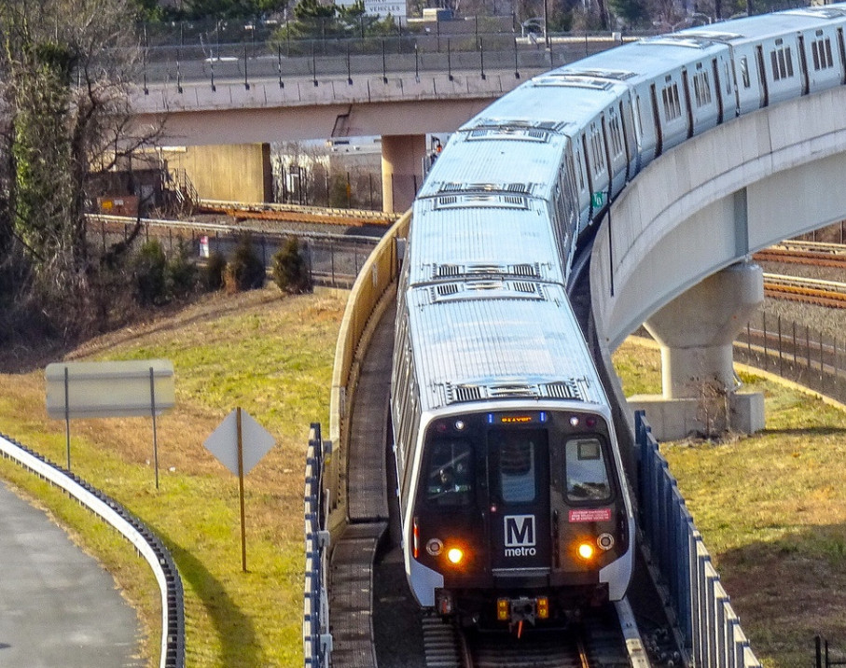


Demonstration
This Photo by Unknown author is licensed under CC BY-NC.

